Slide 1







ANALYSIS OF
CONSUMER PREFERENCES AND TRENDS FOR FOUNDATION AT SEPHORA
ASHLEY DOAN
SELENE NGUYEN

Slide 2





DATA RETRIVAL
01.
02.
03.
Inspect the network activity on sephora’s foundation product pages and identify the json file that contains product information.
Retrieve data from all 5 pages of foundation products using for loop
Convert the data into a dataframe with 11 variables and 262 observations.
Notes:
go to sephora website, search up foundation, inspect the page and identify the json file that contains product information
there's 5 pages in total (~60 products each)

Slide 3

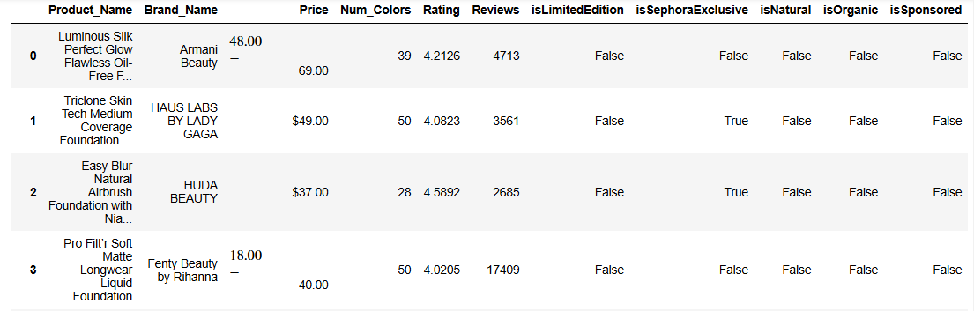



Next Slide

Slide 4

DATA CLEANING
FILTER BY PRODUCT TYPE
CONVERT BOOLEAN VARIABLES
HANDLE PRICE RANGES
CONVERT DATA TYPES
For products with price ranges, select the higher price value as the representative price for full-size products.
Change Price, Num_Colors, Rating, and Reviews to numerical data types.
Retain only products with "foundation" in the name; exclude products containing terms like "brush," "sample," or "pump."
Change boolean values (true, false) in columns such as isLimitedEdition, isSephoraExclusive, isNatural, isOrganic, and isSponsored to binary format (1 for true, 0 for false).
Notes:
even though we put foundation in the search, there's a mix of concealers, bronzers

Slide 5

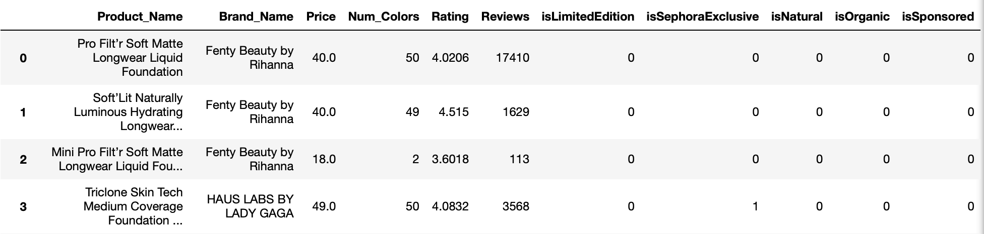

Slide 6
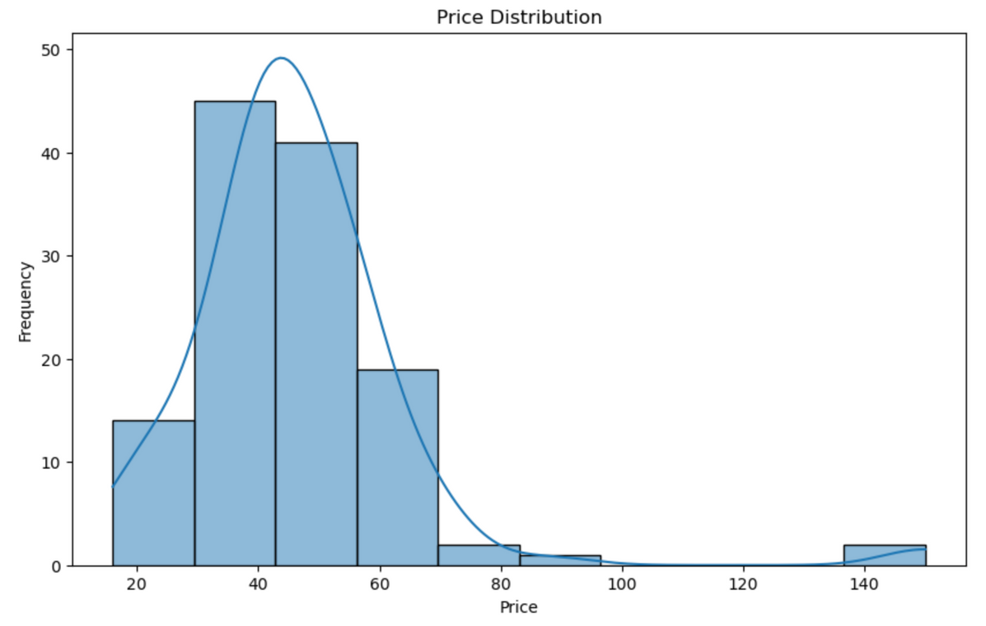
EXPLORATORY DATA ANALYSIS

Slide 7


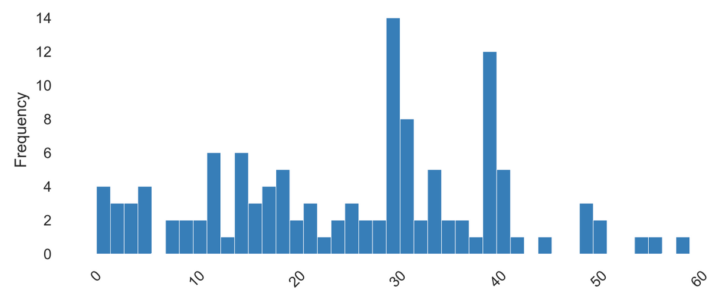
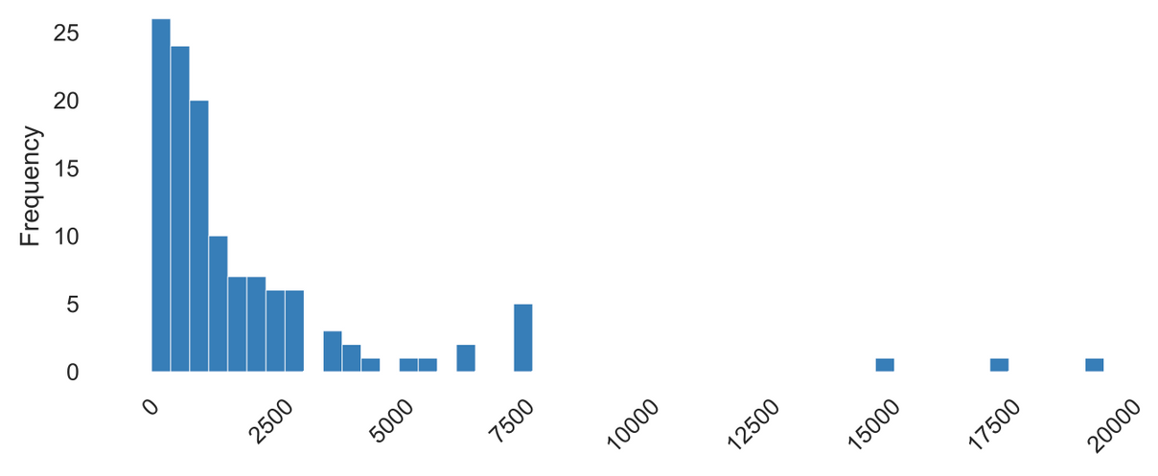
Distribution of Number of Colors
Distribution of Number of Reviews

Slide 8
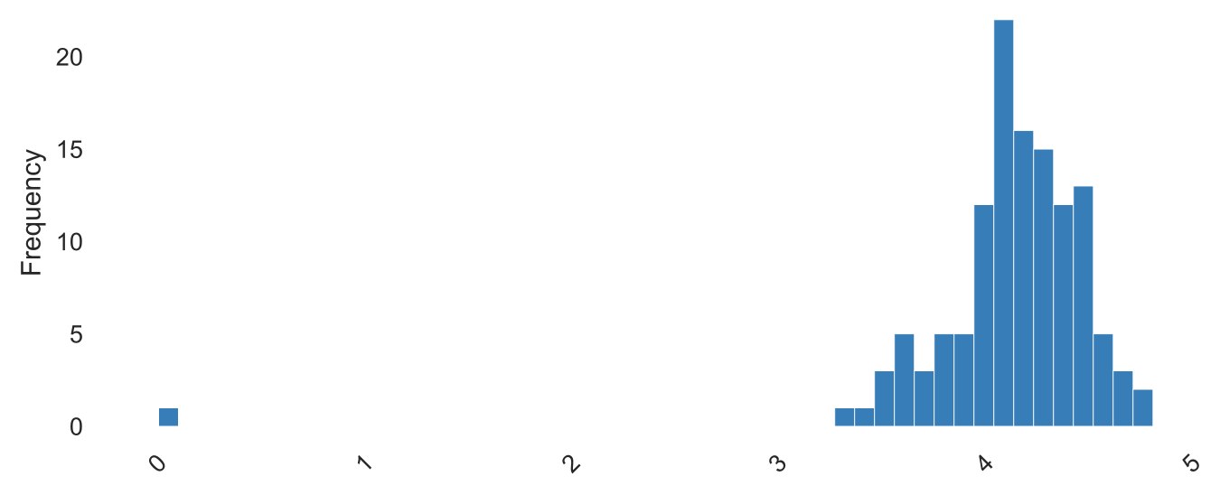
Distribution of Ratings

Slide 9
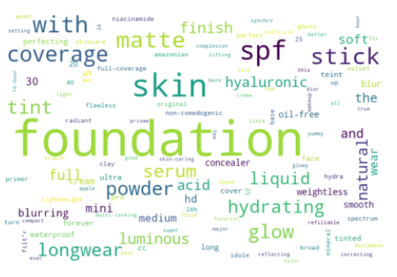
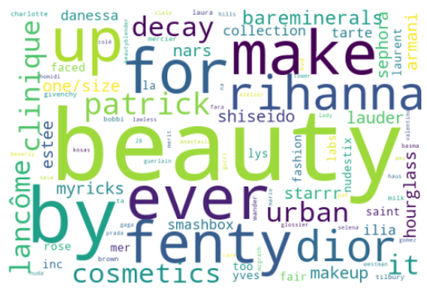
Product Name
Brand Name

Slide 10
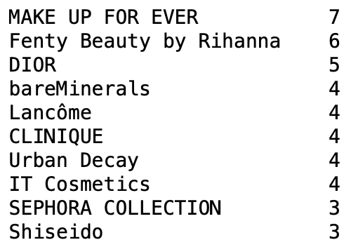
TOP 10 BRANDS WITH MOST PRODUCTS

Slide 11

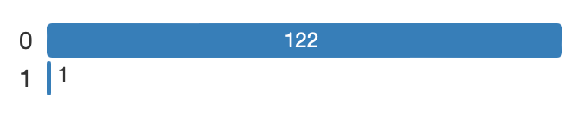

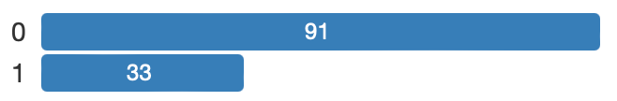

isLimitedEdition
01.
OTHER VARIABLES
isSephoraExclusive
02.
isNatural, isOrganic, & isSponsored
03.

Slide 12
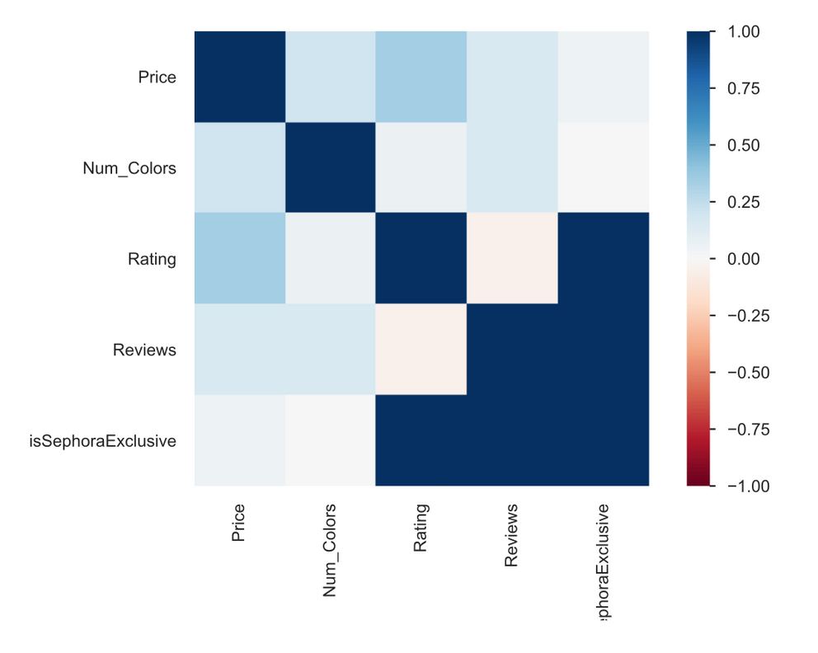
HEATMAP

Slide 13
Data preparation
01.
02.
03.
Drop outliers in the target variable Price.
(just dropped values >100 as opposed to using IQR method)
Drop Variables with only one distinct value (isNatural, isOrganic, isSponsored)
Perform one-hot encoding on categorical variables (Brand_Name, Product_Name)
(convert into numerical format)

Slide 14
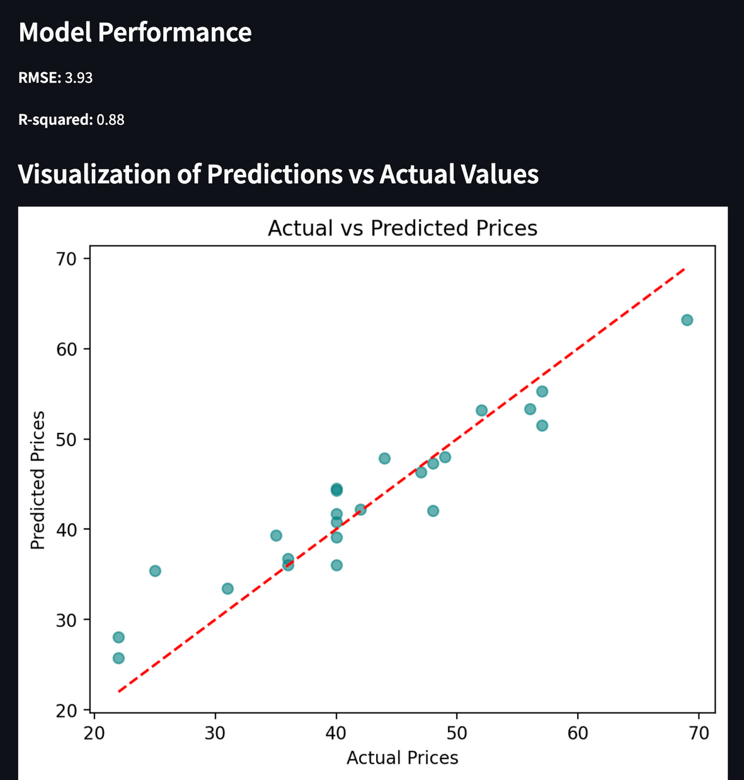
Price Prediction
Model

Slide 15
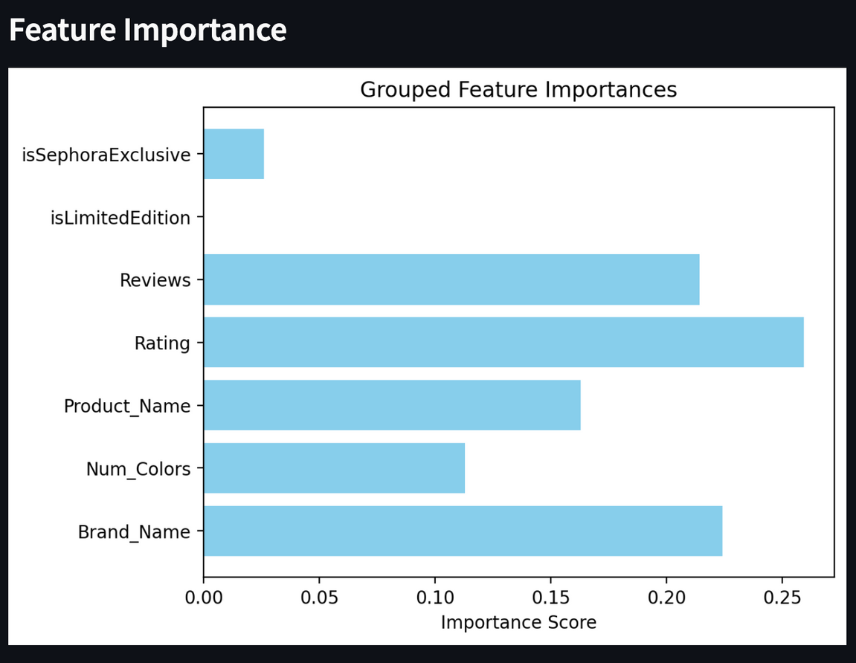
Most important features:
Rating
Brand_Name
Review
Implications:
This findings align with our assumption about the relationship between brand image and a product pricing. Brands that are positioned as premium, along with good rating and reviews (reflecting positive perception of the brand and thus good brand image) are predicted to have high prices.
We are surprised that number of colors does not have a big impact on the pricing of a product, implying that a wider range of product shades (more inclusivity) is not reflected in high product value (in terms of pricing).

Slide 16
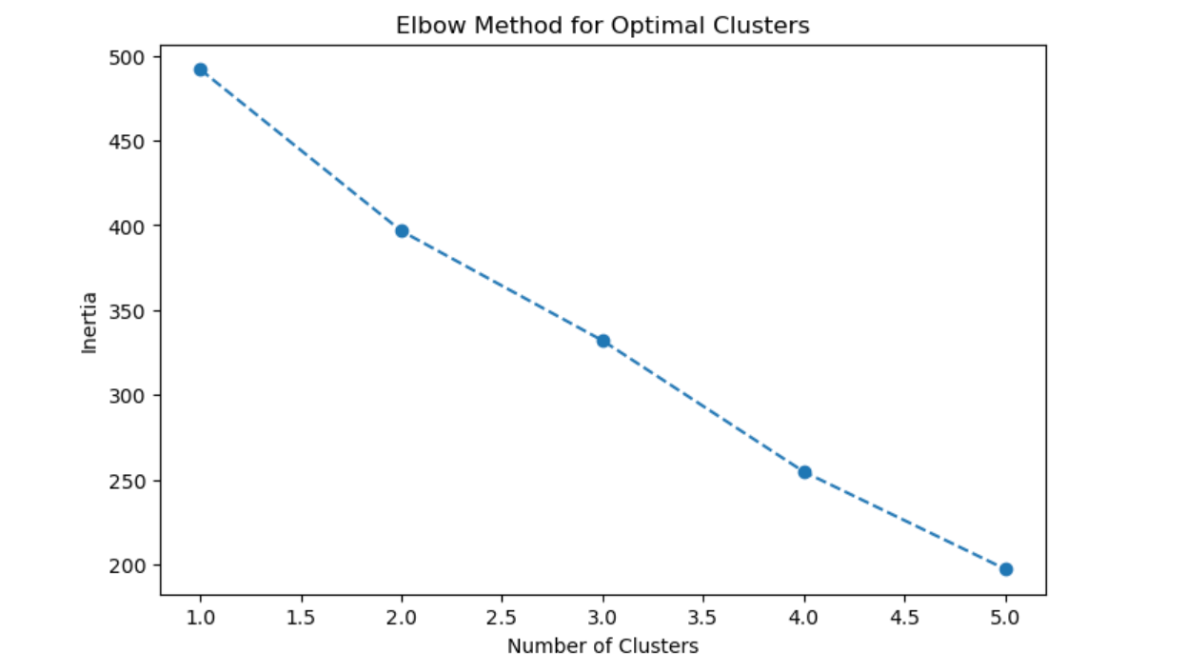
PRODUCT CLUSTERING
The elbow method identifies the optimal number of clusters ('K') in K-means by plotting variance explained against cluster count and locating the point where the improvement sharply levels off.
-> 2 clusters
Notes:
there's not a point where the rate of variance decreases very sharply but it drops the most by 100 from 1 to 2

Slide 17
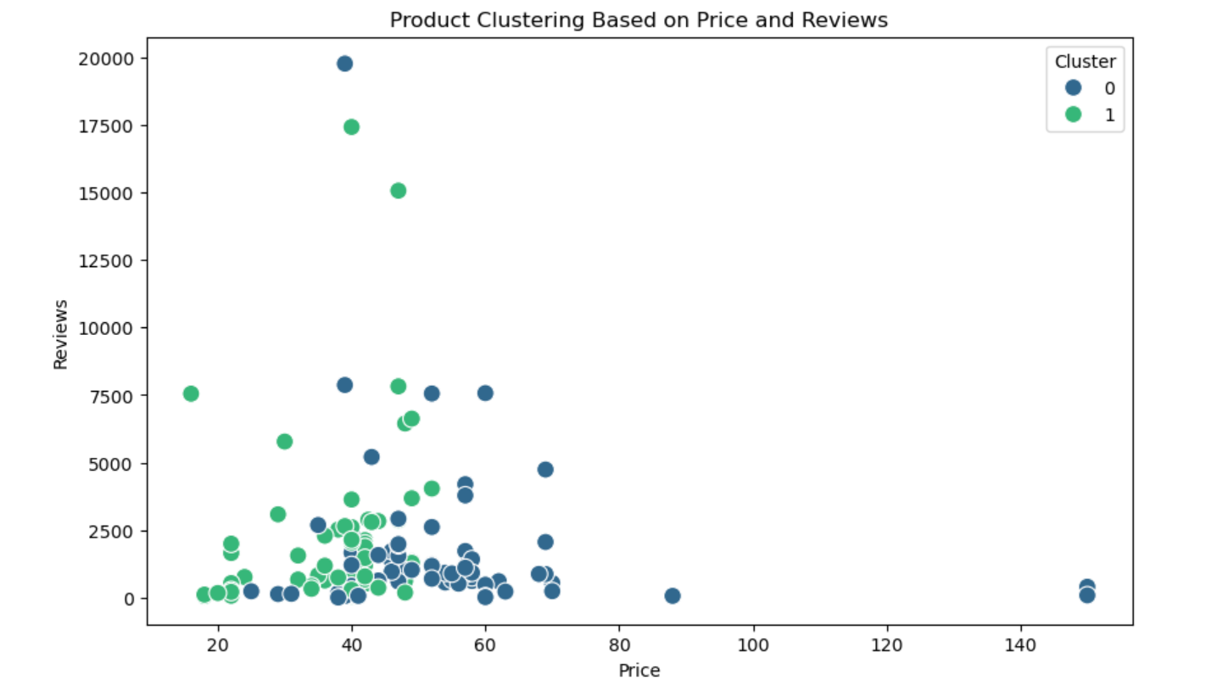
Cluster 0 (blue):
Includes products with a wider price range (from $23 up to $150).
Most of these products have a low to moderate number of reviews (concentrated below ~5,000 reviews).
A few outliers exist with very high prices but little to no reviews.
Cluster 1 (green):
Comprises products mostly in the lower price range (below ~$50).
Many of these products have higher review counts, including products with over 15,000 reviews.
This cluster indicates popular products at a more affordable price point.
Notes:
Key Insights:
High-priced Products they may cater to a niche market and they might reflect luxury or specialty items.

Slide 18
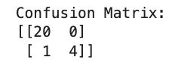
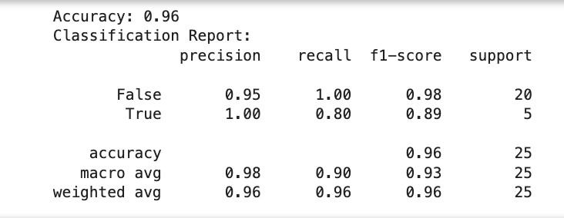
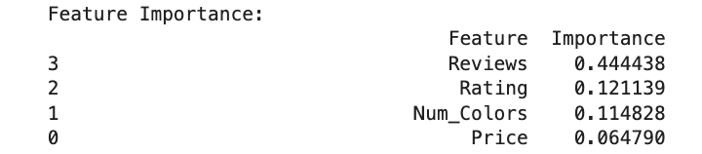
POPULARITY CLASSIFICATION
Create a binary target variable (isPopular: 1 means "Popular" and 0 means "Not Popular") based on:
Reviews > 2255.0 (75th percentile)
Rating >= 4.352475 (75th percentile)
Model: Random Forest Classifier for its simplicity and robustness.
80% for training and 20% for testing
The model achieves a very high accuracy of 96%.
Reviews is the most influential feature, followed by Rating, Num_Colors, and Price.
As I increase the thresholds for reviews and ratings, the accuracy of the model increases and can eventually reach 100%.
Notes:
Random Forest Classifier is used for its simplicity and robustness.
Features like Rating, Reviews, isNatural, and Num_Colors are directly used for training.
The model correctly classified 96% of the total 25 instances.
As I increase the thresholds for reviews and ratings to define a "popular" product (e.g., Reviews > X and Rating >= Y),
When the "True" class becomes very small due to higher thresholds, the model predicts almost all instances as "False" because it is easier to achieve higher accuracy this way
,leading to 100% accuracy (all "False" predictions are correct).
This results in high accuracy but poor performance for identifying "popular" products.

Slide 19
Brand and Pricing
Positive reviews and strong brand names drive higher prices. Businesses should focus on enhancing brand reputation and customer satisfaction to support premium pricing.
01.
Implications For
Stakeholders
Inclusivity and Pricing
The number of colors doesn't significantly affect pricing, suggesting that offering more shades may not justify higher prices. It doesn’t mean that brands should invest less in expanding color options.
02.
High-End Market
03.
Premium products with fewer reviews cater to niche markets. Brands can target high-end consumers by focusing on exclusivity and quality rather than volume of reviews.

Slide 20
Ethical Implications
Legal Implications
Societal Implications
01.
02.
03.
Some with brands limited number of foundation shades may exclude a significant consumer group, contributing to a lack of representation.
The models favor popular or high-rated products, potentially sidelining smaller or lesser-known brands, and limiting consumer choice.
The lack of clear standards for advertising "natural" or "organic" products can lead to misleading claims and greenwashing.
Advertisements for benefits like hydration or long-wear, which are difficult to substantiate, can deceive consumers and misrepresent product effectiveness.
The demand for "limited edition" products creates urgency and a desire for exclusivity, driving overconsumption.
If consumers show interest in eco-friendly products, it could push brands to prioritize sustainability.

Slide 21
THANK YOU!

